Slide 1
Which of the following are not compatible with self-determination?
Investing time to discover a person’s primary goals.
Working with them to determine the pro’s & con’s of this plan
Informing them the best plan of action from your point of personal point of view
Making calls on their behalf to assist in the implementation of their plan

Slide 2
Wed 10/10
I need a volunteer!!!!!!!!!
demonstration
personal issue
a question
a struggle
safe topic

Slide 3
Structural
Comm. Organizer
Planner
Policy advocate
Macropractice specialist
Individual
Caseworker
Therapist
Micropractice specialist
Generalist Practice

Slide 4


Generalist Practice
All levels of client system (Inds, family, groups, neighborhoods, organizations, community)
Assessment
Case management (develop & manage plan)
assess, refer, manage, evaluate
View behavior in larger context
Strengths & Empowerment
IN Summary
All levels
Multiple methods
Broad view of circumstances
Generalist vs. Specialist

Slide 5




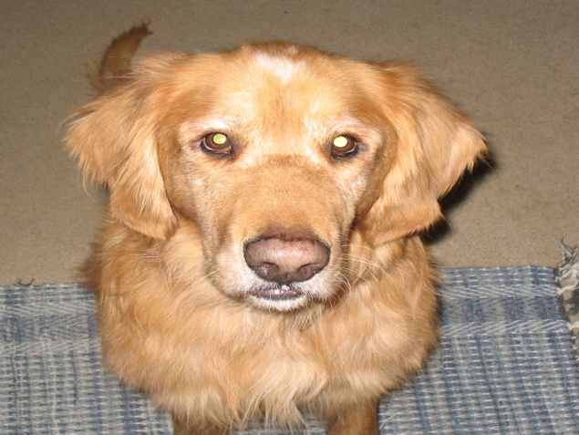
Strengths Orientation

Slide 6
Principles
Individual Strengths
not Pathology
#2
Community is an
Oasis of resources
#1
#3
Self-determination is the
foundation of intervention
#4
Worker-client Relationship
Is primary & Essential

Slide 7
Principles (continued)
#5
Aggressive outreach is the
preferred mode of intervention
#6
Human beings are
capable of learning,
growing. & changing

Slide 9
Heart and Soul of Change
Meta-analysis
  300 controlled studies on outpatient therapy
Client attributes
The relationship
Hope and expectancy
The model
Additional Study 10,000 cases
Biggest correlation to success was clients that provided negative feedback and then became positive (Miller & Duncan, 2003)

Slide 10
Things to watch for- were these things strengths-oriented
(pro’s & con’s)
1) the interviewer’s demeanor
2) questions and responses
3) listening and responding
4) who set the agenda
5) search for resources

