Slide 1
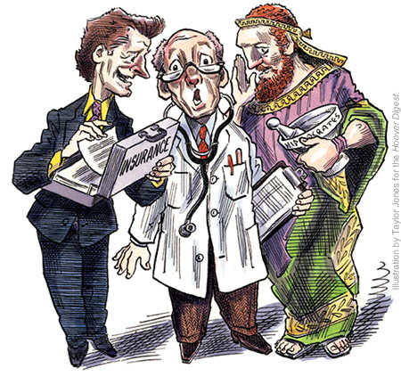
e

Slide 2
Ethics and Social Work
NASW Code of Ethics
Identifies core values
Summarize ethical principles reflect values and upon which standards are based
Framework to use when obligations conflict or ethic are unsure
Ethical standards for accountability
Socialize practitioners
Ruler to assess conduct
Notes:
Pick service settings and possible ethical issues

Slide 3
What it is & isn’t
Values, principles, standards for guidance
Ethical decision-making is a process
Not a set of rules for every situation

Slide 4
Ethical Principles
Service-primary goal is to help people in need and to address social problems
Social Justice-challenge social injustice
Dignity & worth of the person-respect the dignity and worth of every person
Importance of human relationships-recognize the central importance of human relationships
Integrity-behave in a trustworthy manner
Competence-practice within areas of competence and strive to improve expertise

Slide 5
If you were a counselor or social worker, would be uncomfortable working with the following population? Undocumented immigrants A. Yes B. NO

Slide 6
If you were a counselor or social worker, would be uncomfortable working with the following population? Gay, lesbian, Bi-sexual, transgendered youth A. Yes B. NO

Slide 7
If you were a counselor or social worker, would be uncomfortable working with the following population? Sexual Perpetrators A. Yes B. NO

Slide 8
Standards (enforceable/aspirational)
Commitment to clients
exceptions
Informed Consent
Disclosure
Comprehension
3rd party if needed
Involuntary
Disclosure & refusal rights
Caveats of electronic media
Informed Consent prior to observation/taping
Self-determination
id & pursue goals
Awareness of risks
Competence
Accurate representation Prepare & care

Slide 9
Standards (enforceable/aspirational)
Cult Comp. & Diversity
Understanding
Possess/Develop knowledge
Conflict of Interest
Clarify & keep clients primary
Exploitation
Dual relationships

Slide 10
Case Examples
A juvenile justice facility is run by a religious order of Brothers. The program has a spirituality component based on Catholicism. Many of the youth in this facility are not Catholic: Baptists & Non-practicing self-proclaimed atheists.
Ethical issues, How do you make sense of the ethical concerns, what do you suggest?

Slide 11
Mother and custody
You are working with a mother whose infant child is in a foster home. She has been straight for 9 weeks, but refuses to go to the treatment program ordered by the court. She says the program is based on a religious model that does not fit her beliefs. A review hearing is coming up where the judge will assess her fitness to be a mother.
Ethical issues, Ethical issues, How do you make sense of the ethical concerns, what do you suggest?

